Slide 1
DEVOPS
(Kubernetes)
Zouhair OUHDID

Slide 2
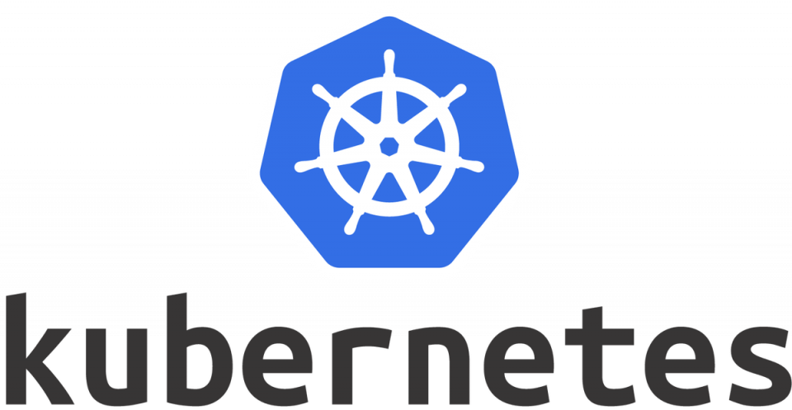
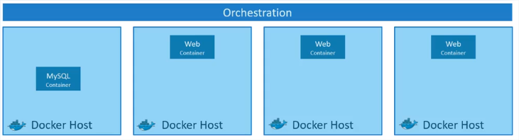
Kubernetes est une plateforme open source d’orchestration de conteneurs
créé par Google

Slide 3
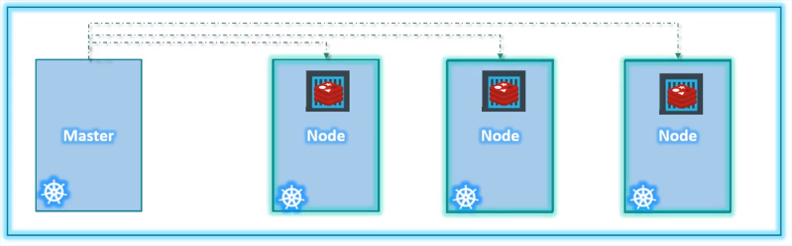
Architecture

Slide 4
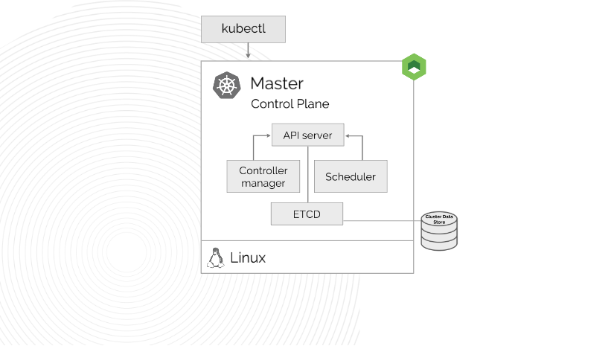
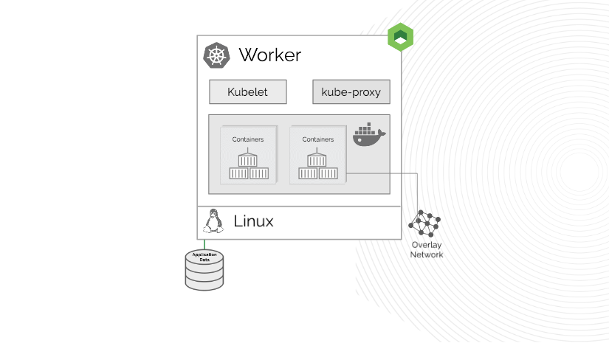
Architecture

Slide 5
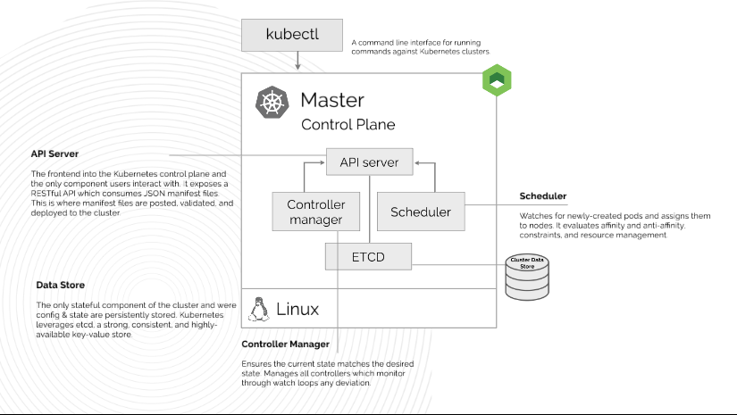
Architecture

Slide 6
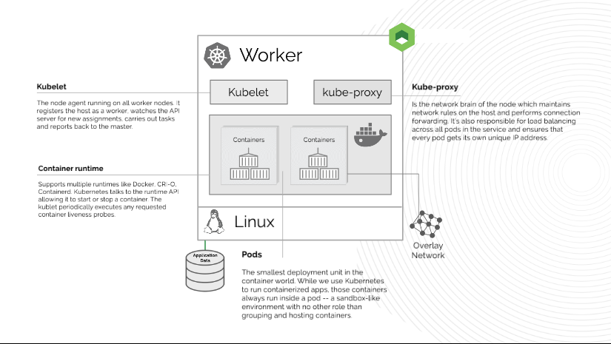
Architecture

Slide 7
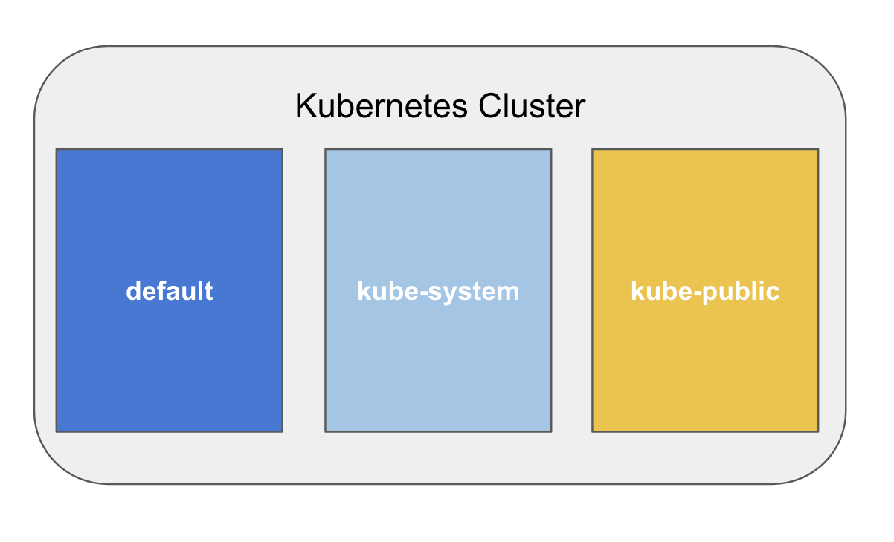
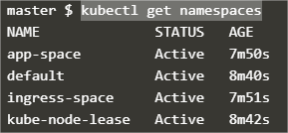
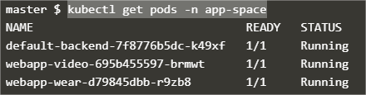
Namespaces

Slide 8
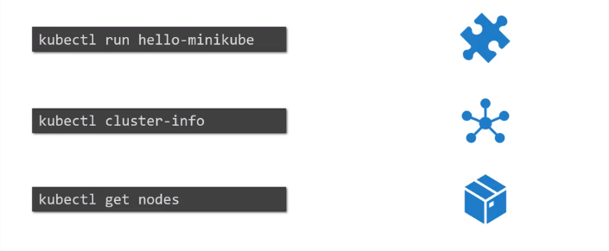
Kubectl command
Memo Kubectl:
https://kubernetes.io/fr/docs/reference/kubectl/cheatsheet/

Slide 9
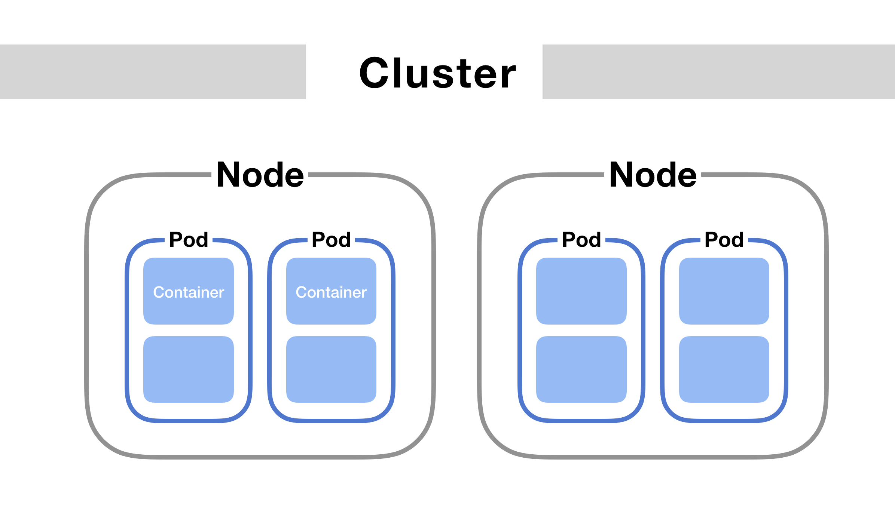
PODs
Un POD est l’objet le plut petit d’un cluster Kubernetes
Un POD encapsule un ou plusieurs conteneurs

Slide 10
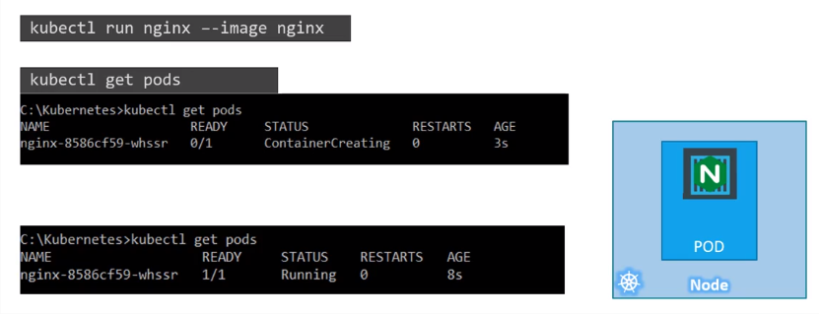
PODs

Slide 11
PODs
DEMO :
Create pod from nginx image:
Kubectl run nginx --image=nginx:latest
List pods :
Kubectl get pods -o wide
Show details of the pod created:
Kubectl describe pods/nginx

Slide 12
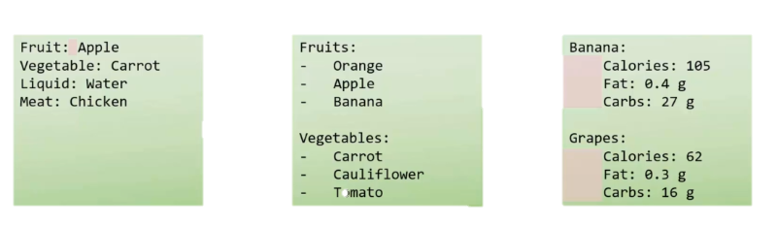
YAML
Key - value
Arrays/List
Dictionnary/Map

Slide 13
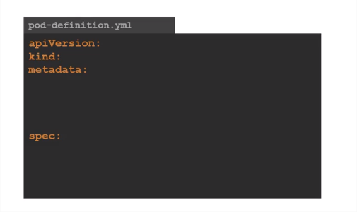
PODS with YAML

Slide 14
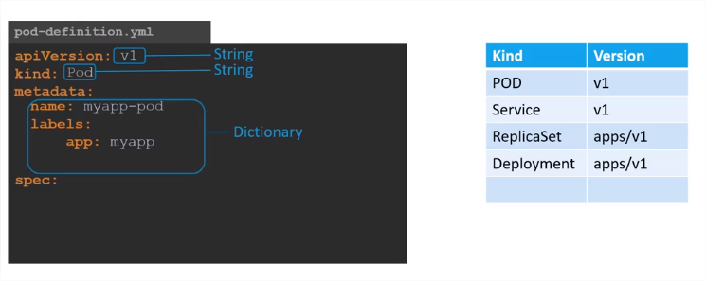
PODS with YAML

Slide 15
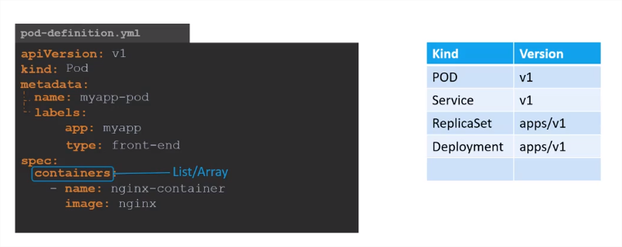
PODS with YAML

Slide 16
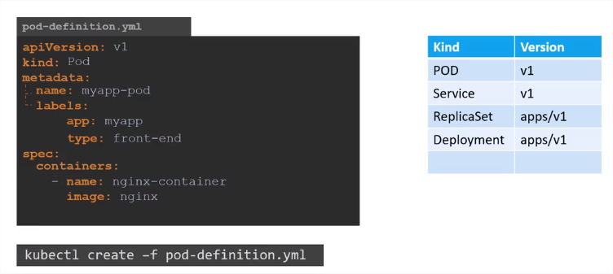
PODS with YAML

Slide 17
PODS with YAML
Liste des versions API:

Slide 18
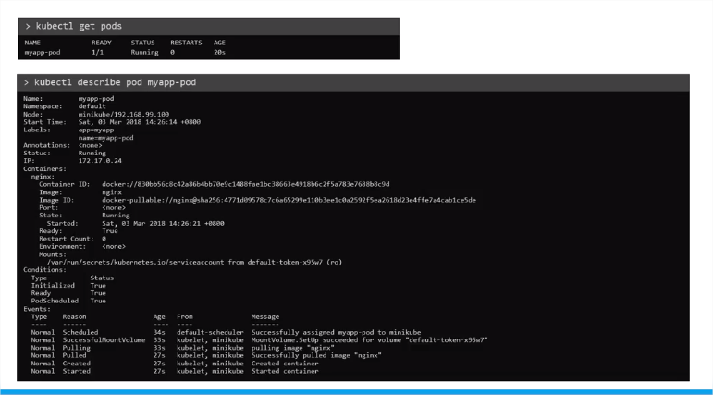
PODS with YAML

Slide 19
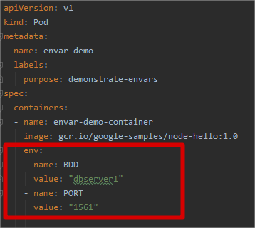
Environment variables

Slide 20
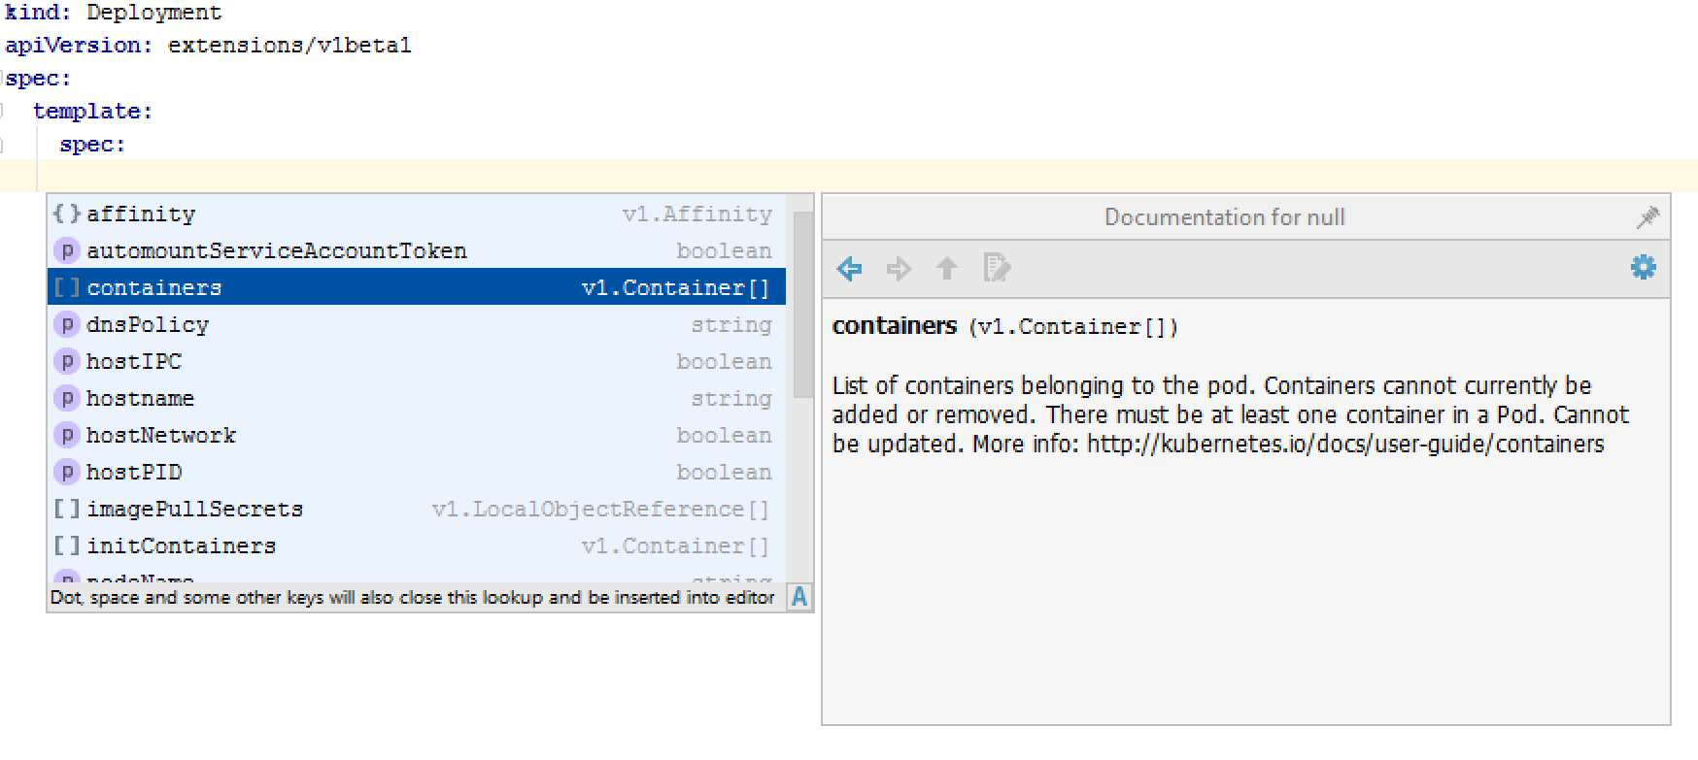
Autocompletion Plugin
https://plugins.jetbrains.com/plugin/9354-kubernetes-and-openshift-resource-support/versions

Slide 21
LAB
https://kodekloud.com/p/public-labs?scenario=kubernetes-for-beginners-pods-new

Slide 22
ConfigMaps
Les ConfigMaps sont utiles pour stocker et partager des informations de configuration non chiffrées et non sensibles.
Pour utiliser des informations sensibles dans les clusters, vous devez vous servir de secrets.
kind: ConfigMap apiVersion: v1 metadata: name: example-configmap data: database: mongodbsrv database_uri: mongodbsrv://localhost:27017
apiVersion: v1
kind: Pod metadata: name: pod-env-var spec: containers: - name: env-var-configmap image: nginx:1.7.9 env: - name: DB valueFrom: configMapKeyRef: name: example-configmap key: database
apiVersion: v1 kind: Pod metadata: name: webapp-color labels: name: webapp-color spec: containers: - image: kodekloud/webapp-color name: webapp-color envFrom: - configMapRef: name: webapp-config-map

Slide 23
Secrets
Les secrets sont des objets sécurisés qui stockent des données sensibles, telles que les mots de passe et les clés SSH, Le stockage des données sensibles dans des secrets est plus sécurisé que le stockage sous format texte brut dans ConfigMaps ou dans les spécifications d'un pod.
echo -n 'admin' | base64
YWRtaW4=
echo -n '1f2d1e2e67df' | base64
MWYyZDFlMmU2N2Rm
apiVersion: v1 kind: Pod metadata: name: webapp-pod spec: containers: - image: kodekloud/simple-webapp-mysql imagePullPolicy: Always name: webapp envFrom: - secretRef: name: db-secret
apiVersion: v1 kind: Secret metadata: name: credentials namespace: default data: password: MWYyZDFlMmU2N2Rm username: YWRtaW4=

Slide 24
Volumes
Disque sur Nœud :
apiVersion: v1 kind: Pod metadata: name: test-pd spec: containers: - image: k8s.gcr.io/test-webserver name: test-container volumeMounts: - mountPath: /test-pd name: test-volume volumes: - name: test-volume hostPath: path: /data
Disque sur Azure Storage :
apiVersion: v1 kind: Pod metadata: name: test-pd spec: containers: - image: k8s.gcr.io/test-webserver name: test-container volumeMounts: - mountPath: /test-pd name: test-volume volumes:
- name: azurefileshare
azureFile:
secretName: storageaccount-secret
shareName: myfileshare

Slide 25
LAB
https://kodekloud.com/courses/certified-kubernetes-administrator-with-practice-tests-labs/lectures/12038802
https://kodekloud.com/courses/certified-kubernetes-administrator-with-practice-tests-labs/lectures/12038804

Slide 26
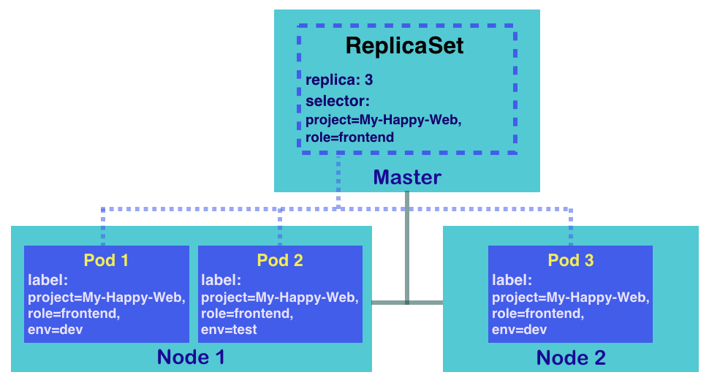
ReplicaSet
High Availability/Scaling
Un ReplicaSet est utilisé pour garantir la disponibilité d’un certain nombre identique de Pods.

Slide 27
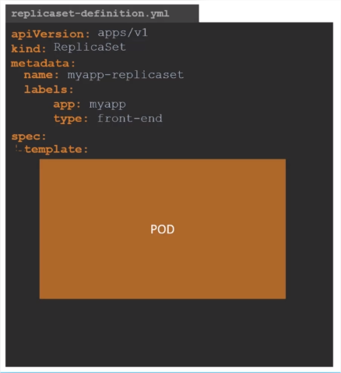
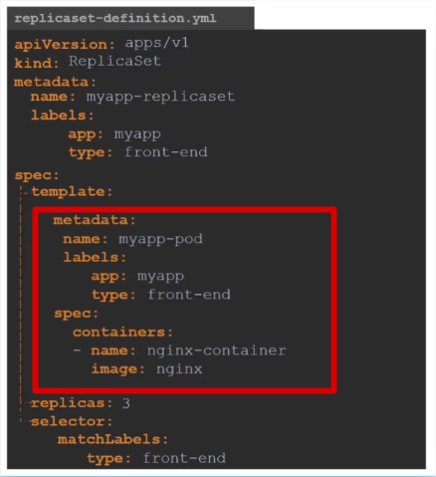
ReplicaSet

Slide 28
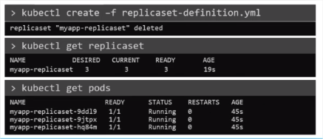
ReplicaSet

Slide 29
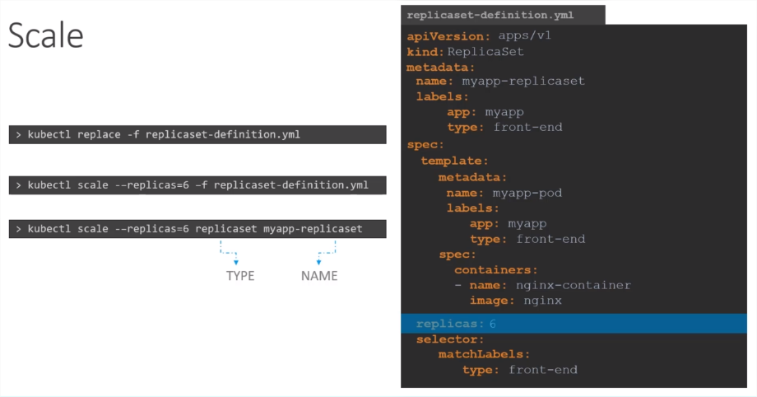
ReplicaSet

Slide 30
LAB
https://kodekloud.com/p/public-labs?scenario=kubernetes-for-beginners-replicasets-new
ReplicaSet YAML Example:
https://kubernetes.io/fr/docs/concepts/workloads/controllers/replicaset/#exemple

Slide 31
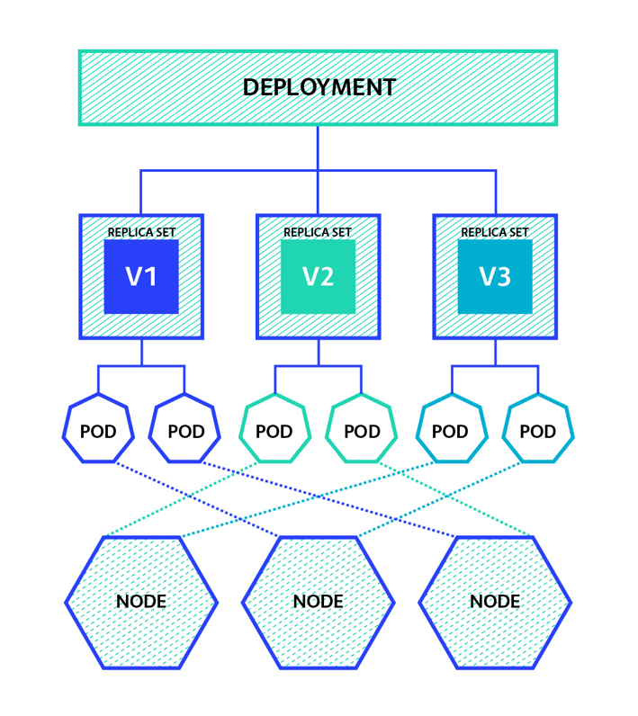
Deployment
Un Déploiement est un objet Kubernetes qui vient encapsuler les ReplicaSets
Un Déploiement permet un roll out et roll back des versions des images
Un Déploiement permet la mise à jour progressive des nouvelles versions de l’application (rolling-update)

Slide 32
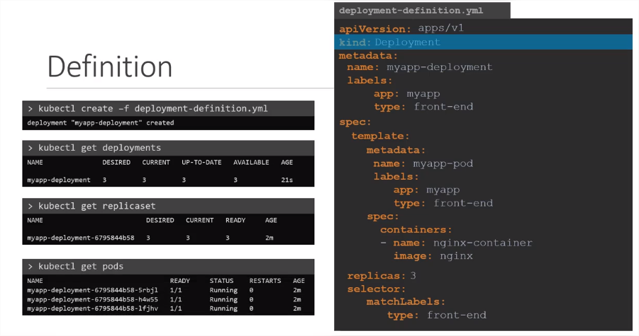
Deployment

Slide 33
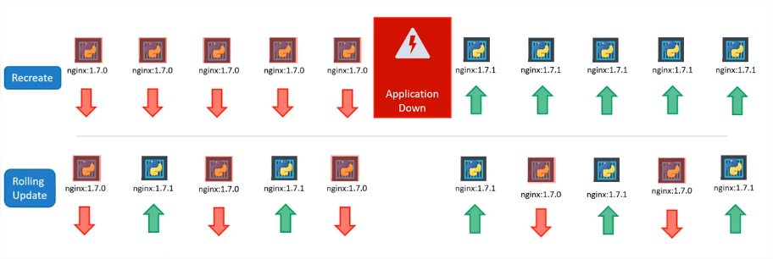
Déployment Strategy

Slide 34
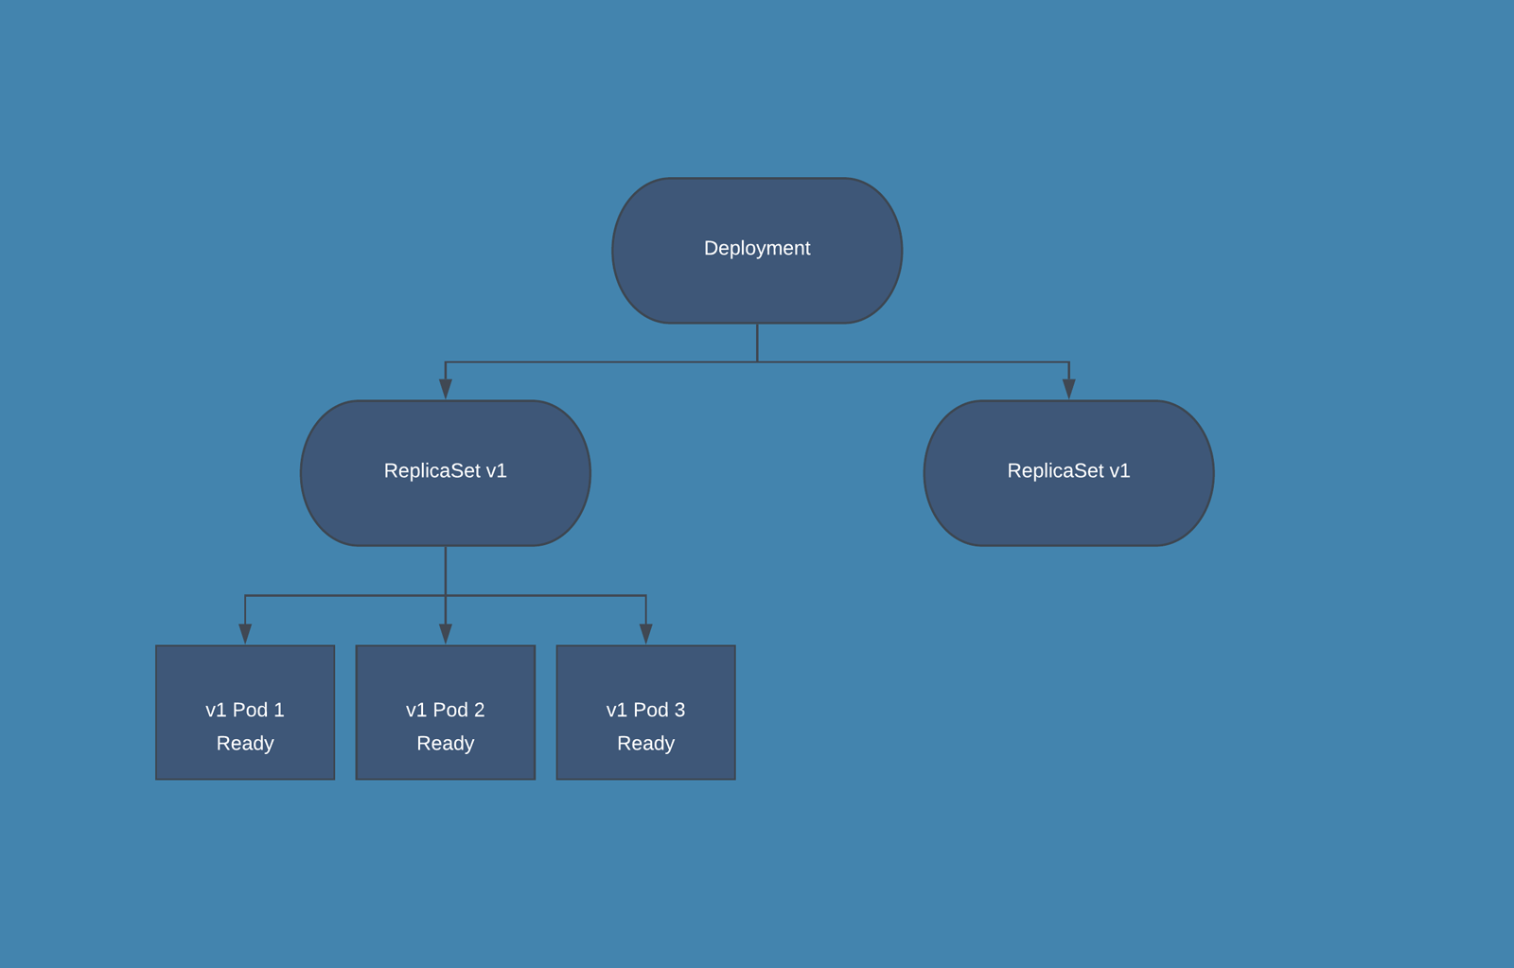
Rolling-Update

Slide 35
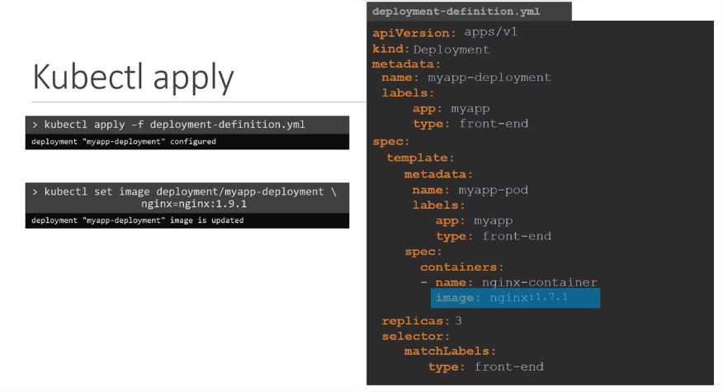
Déployment (MAJ image)

Slide 36
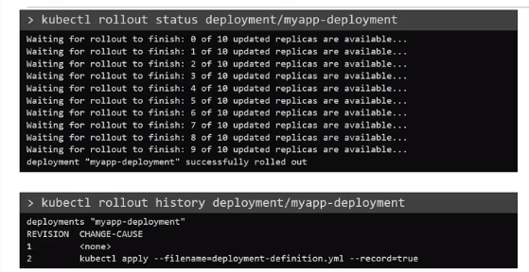
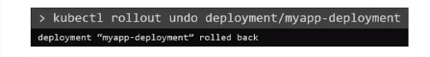
Rollout,RollBack

Slide 37
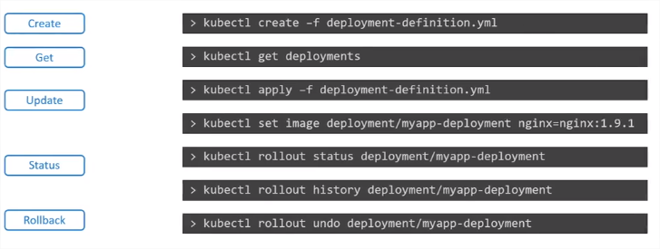
Deployment Commands

Slide 38
LAB
https://kodekloud.com/p/public-labs?scenario=kubernetes-for-beginners-deployments-new
Deployment YAML Example:
https://kubernetes.io/fr/docs/concepts/workloads/controllers/deployment/#cr%c3%a9ation-d-un-d%c3%a9ploiement

Slide 39
DEMO

Slide 40
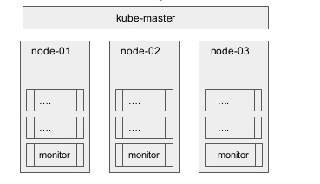
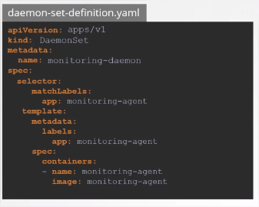
DaemonSets
runs a pod on every node
not a fixed number of replicas (created and deleted as nodes come and go)
useful for running cluster-wide services (logging agents)

Slide 41
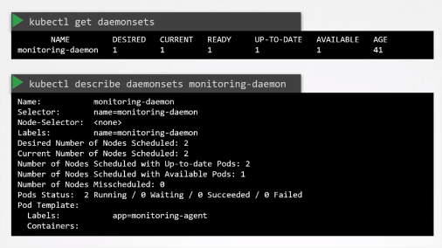
DaemonSets

Slide 42
LAB
https://kodekloud.com/courses/certified-kubernetes-administrator-with-practice-tests-labs/lectures/12038838

Slide 43
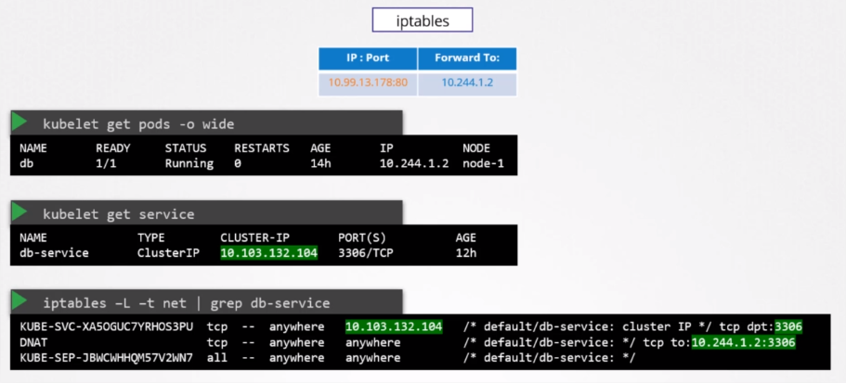
Kube-Proxy
Kube-proxy est l’objet permettant de router le trafic adressé
aux services vers les pods appropriés.
Kube-proxy peut fonctionner dans l'un des trois modes, chacun implémenté avec différentes technologies de plan de données: userspace, iptables ou IPVS.

Slide 44
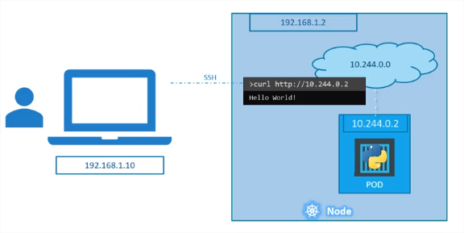
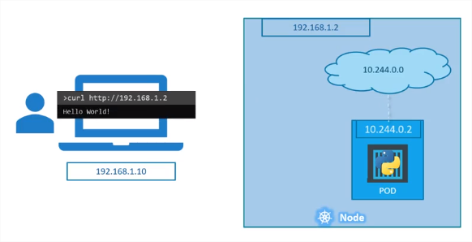
Networking

Slide 45
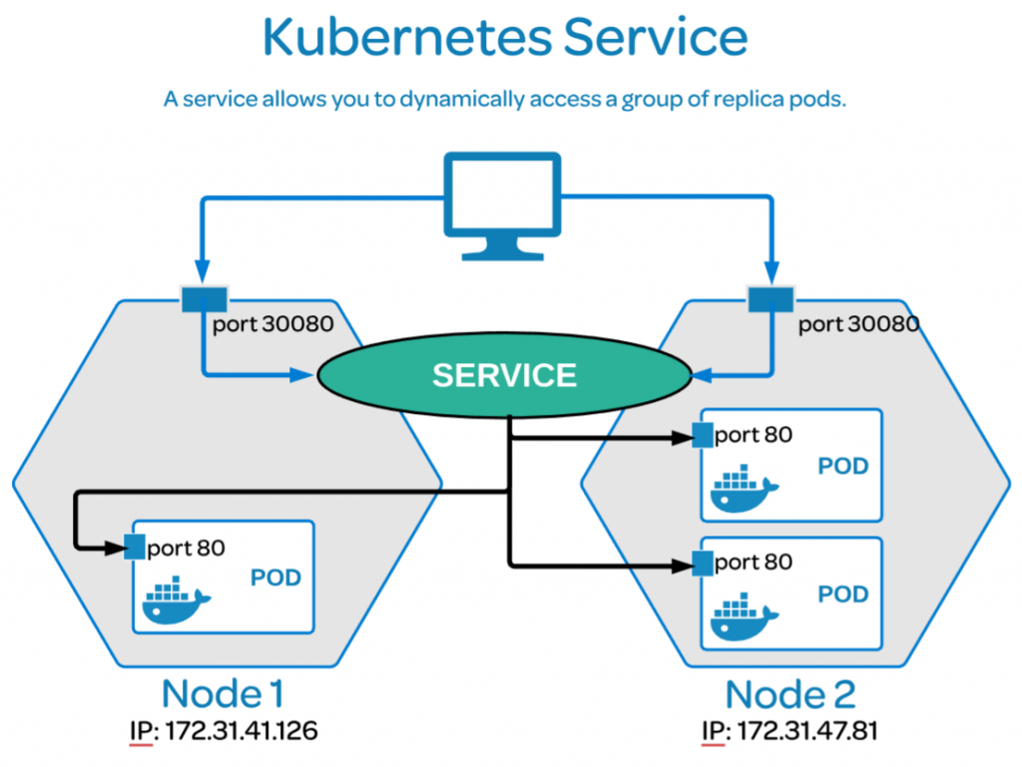
Services
Un Service est un objet kubernetes présentant un SPOC (single point of contact) permettant de regrouper l’accès aux pods.
Il équilibre la charge du trafic en utilisant le round-robin des connexions réseaux sur l'ensemble des pods correspondants au sélecteur de label.

Slide 46
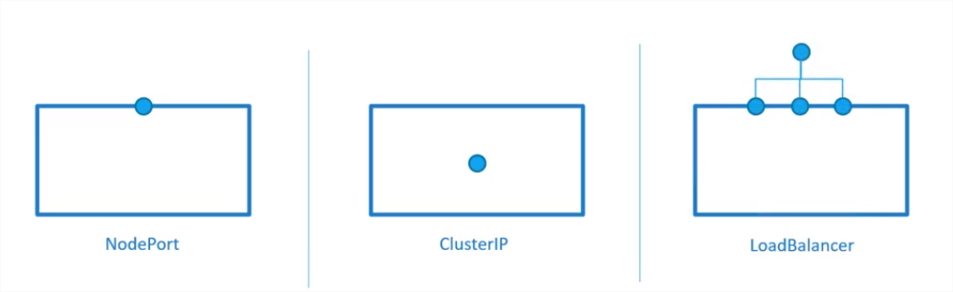
Types de Services
ClusterIP: Expose le service sur une IP interne au cluster. accessible à partir du cluster. Il s’agit du ServiceType par défaut.
NodePort: Expose le service sur l’IP de chaque nœud sur un port statique (le NodePort).
LoadBalancer: Expose le service en externe à l’aide de l’équilibreur de charge d’un fournisseur de cloud

Slide 47
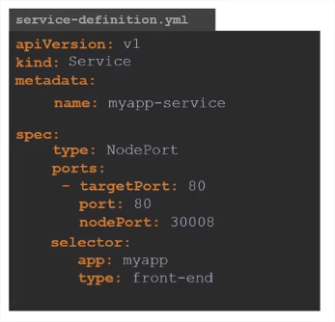
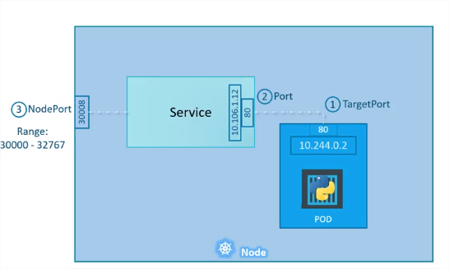
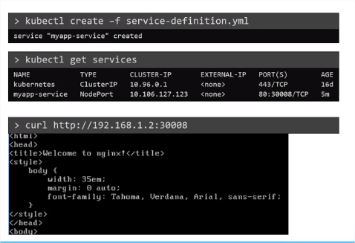
NodePort Service

Slide 48
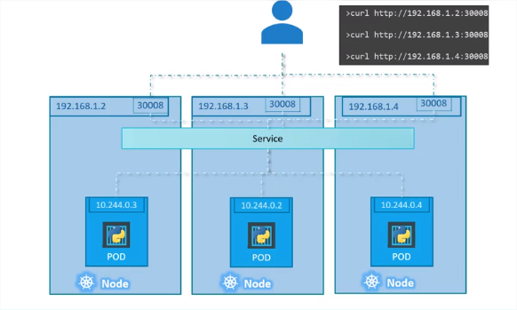
NodePort Service

Slide 49
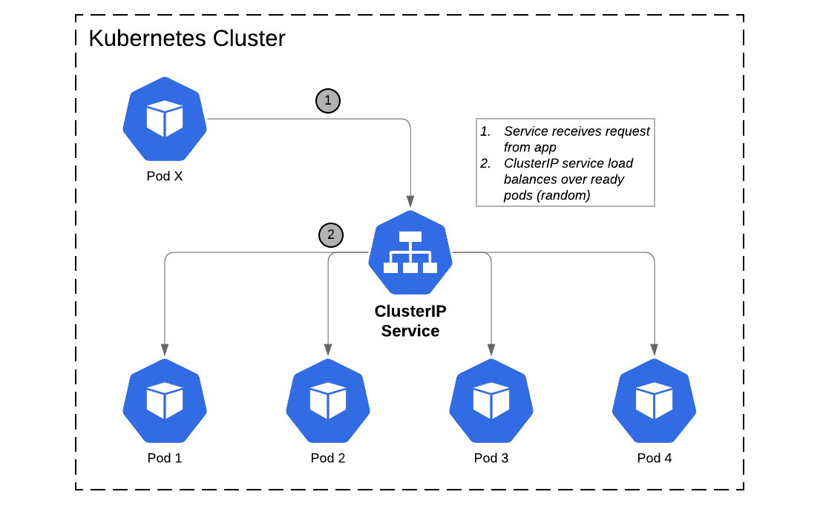
Cluster-ip Service

Slide 50
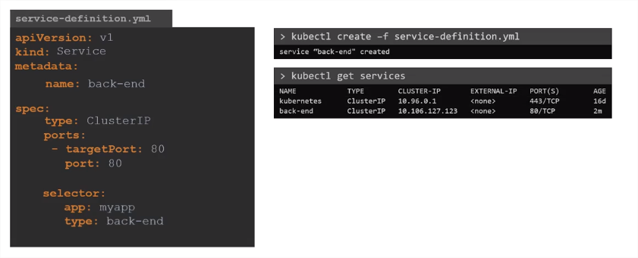
Cluster-ip Service

Slide 51
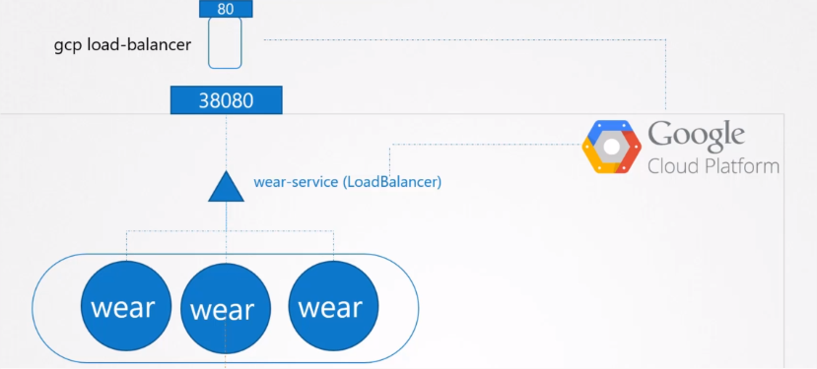
Loadbalancer Service

Slide 52
Loadbalancer Service
apiVersion: v1 kind: Service metadata: name: my-service spec: type: LoadBalancer ports: - protocol: TCP port: 80 targetPort: 9376 nodePort: 30003 selector: app: MyApp

Slide 53
LAB
https://kodekloud.com/p/public-labs?scenario=kubernetes-for-beginners-services-new
YAML Service Example
https://kubernetes.io/fr/docs/concepts/services-networking/service/#d%c3%a9finition-d-un-service

Slide 54

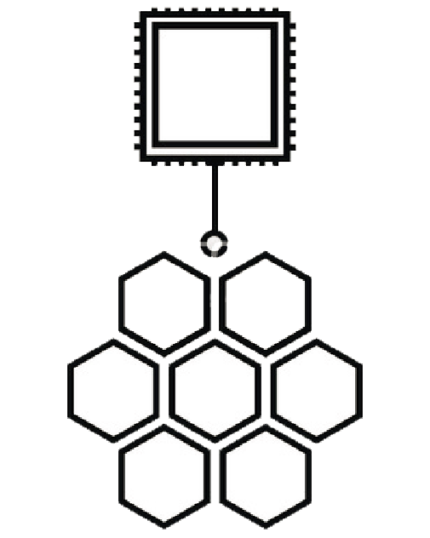
Ingress
www.sephora.com/MAKEUP
www.sephora.com/HAIR
LoadBalancer
www.sephora.com/SKINCARE
LoadBalancer
LoadBalancer
Service MAKEUP
Service SKINCARE
Service HAIR
Kubernetes Cluster

Slide 55

www.sephora.com/SKINCARE
www.sephora.com/MAKEUP
www.sephora.com/HAIR
LoadBalancer
LoadBalancer
LoadBalancer
INGRESS
Service MAKEUP
Service SKINCARE
Service HAIR
Kubernetes Cluster

Slide 56



Ingress
Ingress Controller
Ingress Ressources

Slide 57

INGRESS Controller

Slide 58


INGRESS Resources

Slide 59

INGRESS Resources

Slide 60


INGRESS Resources

Slide 61

INGRESS TLS
kubectl create secret tls example-com-tls --cert=certificat.crt --key=private.key
ingressrules.yml
kubectl create –f ingressrules.yml

Slide 62
LAB
https://kodekloud.com/courses/675080/lectures/12038778

Slide 63

Installation on Premise
Référence:
https://kubernetes.io/docs/setup/production-environment/tools/kubeadm/install-kubeadm/
https://kubernetes.io/docs/setup/production-environment/tools/kubeadm/create-cluster-kubeadm/

Slide 64
Ports utilisés
Control-plane(master) node(s)
Protocol | Direction | Port Range | Purpose | Used By
TCP | Inbound | 6443* | Kubernetes API server | All
TCP | Inbound | 2379-2380 | etcd server client API | kube-apiserver, etcd
TCP | Inbound | 10250 | Kubelet API | Self, Control plane
TCP | Inbound | 10251 | kube-scheduler | Self
TCP | Inbound | 10252 | kube-controller-manager | Self
Worker node(s)
Protocol | Direction | Port Range | Purpose | Used By
TCP | Inbound | 10250 | Kubelet API | Self, Control plane
TCP | Inbound | 30000-32767 | NodePort Services† | All

Slide 65
LAB
https://www.katacoda.com/courses/kubernetes/getting-started-with-kubeadm

Slide 66
Connect to Kubernetes Cluster
All Kubernetes clusters have two categories of users:
service accounts managed by Kubernetes and normal users.
Normal users are assumed to be managed by an outside, independent service. An admin distributing private keys, a user store like Keystone or Google Accounts, even a file with a list of usernames and passwords.
In this regard, Kubernetes does not have objects which represent normal user accounts.
Normal users cannot be added to a cluster through an API call.

Slide 67



Connect to Kubernetes Cluster
Authentication via ServiceAccounts

Slide 68

Connect to Kubernetes Cluster
Authentication via Certificates
Sur le client, Générer une clé privée et une demande de signature
Sur le master, signer le certificat , et l’envoyer au client + le certificat CA

Slide 69

Connect to Kubernetes Cluster
Authentication via Certificates
Se connecter via kubectl
Présenter le certificat et la clé privée client + certificat CA

Slide 70


Connect via Kubeconfig file
config

Slide 71

Kubeconfig

Slide 72


Slide 73
L’ordre de recherche du fichier config par la commande kubectl:
L’option --kubeconfig
La variable d’environnement KUBECONFIG
Le fichier $HOME/.kube/config

Slide 74


Slide 75


Slide 76
Kubeconfig commands
Kubectl config view
kubectl config view --kubeconfig my-kube-config
Kubectl config get-contexts
Kubectl config current-context
Kubectl config use-context
kubectl config set-cluster dev --server=https://172.1.23.5:8443 --certificate-authority=path-to-ca-file
kubectl config set-credentials developer --client-certificate=cert-file --client-key=privkey
kubectl config set-context developer-dev --cluster=dev --user=developer

Slide 77
LAB
https://kodekloud.com/courses/certified-kubernetes-administrator-with-practice-tests-labs/lectures/12038710

Slide 78

TroubleShooting
Pods

Slide 79

TroubleShooting
Worker Nodes

Slide 80



TroubleShooting
Master Node

Slide 81

TroubleShooting
Kubelet Agent
Kubelet Service config:
/etc/systemd/system/kubelet.service.d/10-kubeadm.conf
/etc/systemd/system/kubelet.service
/etc/kubernetes/kubelet.conf
/var/lib/kubelet/config.yaml

Slide 82
LAB
https://kodekloud.com/courses/certified-kubernetes-administrator-with-practice-tests-labs/lectures/12038892
https://kodekloud.com/courses/certified-kubernetes-administrator-with-practice-tests-labs/lectures/12038894

Slide 83
THE END
Thank you ☺

